Slide 1
DE-INBRE Flight School 16 & 23 Feb 2021 Robert Akins, PhD

Slide 2
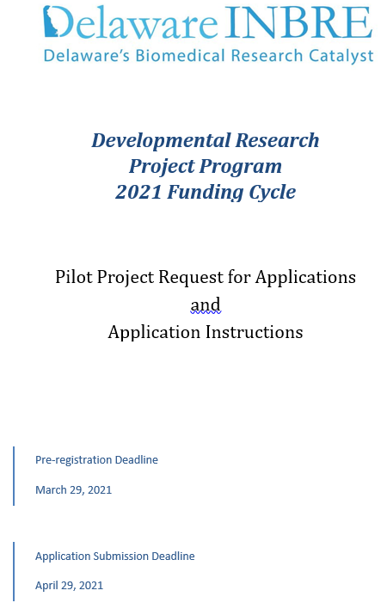
DE-INBRE Flight School: READ THE RFA THOROUGHLY Robert Akins, PhD
This session provides an overview and a chance to ask questions. It is not comprehensive. Details are in the RFA.
http://de-inbre.org/

Slide 3
DE-INBRE Flight School: Background, Goals, and Objectives Robert Akins, PhD
Research Independence Award | Research Engagement Award
NIH R01 | NIH R15
NSF CAREER | NIH R34
NSF PECASE | NIH K01
NIH R41/42 | NIH K07
NIH R43/44 | NIH K08
NIH P01 | NIH K23
NIH P20 | NIH K25
 | NSF RUI/ROA
Table 1: Grants that may be targeted by a Pilot Awardee.
Two types pilot award mechanisms
Research Independence Awards
Research Engagement Awards
Lead to grant applications that clearly propel an investigator toward establishing a sustainable research program

Slide 4
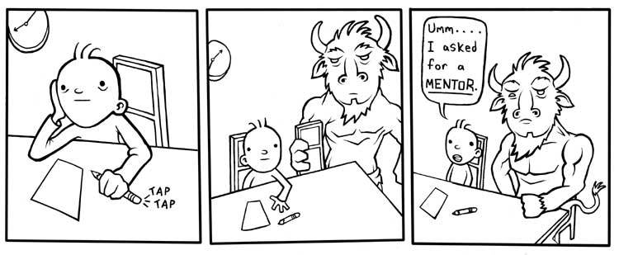
DE-INBRE Flight School: Mentoring Requirement
Robert Akins, PhD
Principal mentor must
Be an established investigator
Be experienced in the area of the applicant’s proposal
Demonstrate commitment to the applicant’s development
Have an established record of training junior faculty
Applicants are encouraged to identify more than one mentor.
The candidate must work with their mentor(s) in preparing the Pilot Project application.
http://spikepit.wordpress.com/

Slide 5
DE-INBRE Flight School: Eligibility
Robert Akins, PhD
A DE-INBRE Pilot applicant must:
Hold a full-time tenured, tenure-track, or equivalent faculty appointment;
Be based at a DE-INBRE partner institution;
Fulfill be an NIH New Investigator: An investigator who has not previously competed successfully for substantial, independent funding from NIH.

Slide 6
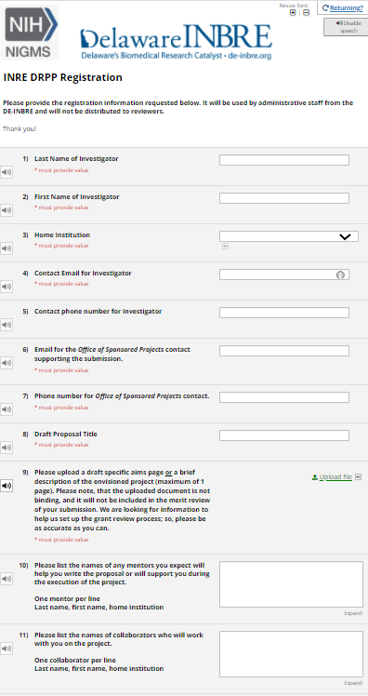
DE-INBRE Flight School: Registration & Cover Letter
Robert Akins, PhD
Register online by March 29th ***THIS IS REQUIRED***
https://redcap.nemoursresearch.org/redcap/surveys/?s=XNXNFLWTTF
Provide a cover letter with the submission:
Title of the proposal and mechanism
Thematic area(s) addressed (neuroscience, cardiovascular, or cancer research)
Three or four potential scientific reviewers
familiar with the area of research
need not be from Delaware
professional familiarity with the applicant okay, but a reviewer cannot have a significant conflict of interest.

Slide 7
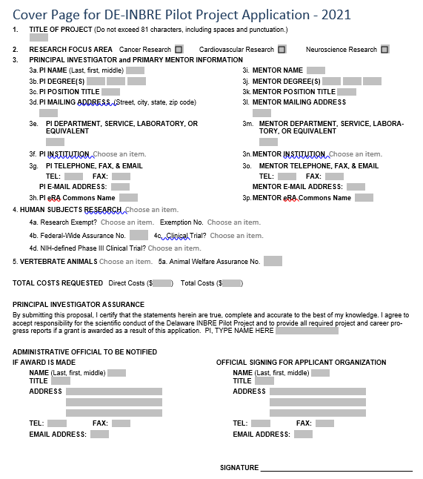
DE-INBRE Flight School: Face Page
Robert Akins, PhD
Work with your OSP to fill this out – they have seen these before and will know what to do.

Slide 8
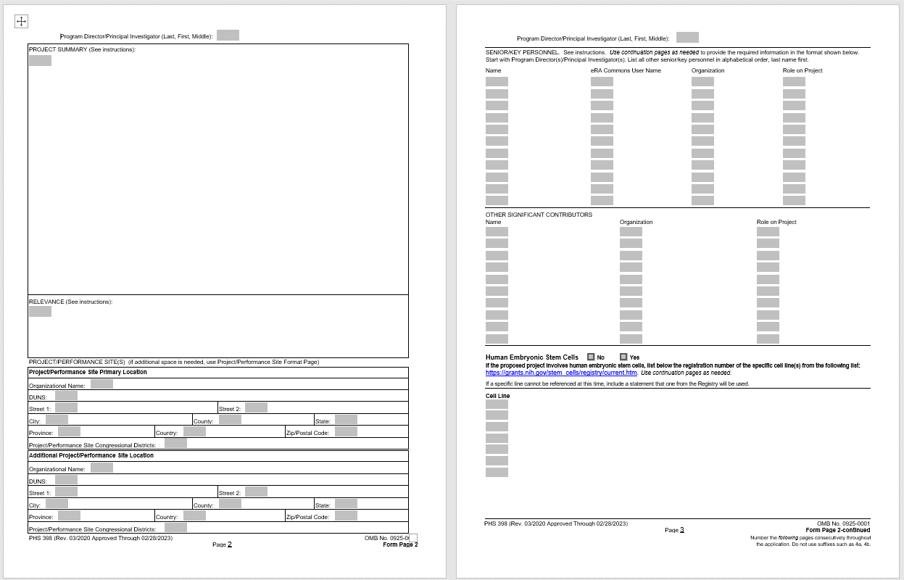
DE-INBRE Flight School: Required Administrative Forms
Robert Akins, PhD
Work with your OSP to fill out any NIH “398 forms (they have seen them before and will know what to do).
Detailed directions can be found at https://grants.nih.gov/grants/funding/phs398/phs398.pdf
Summary
Relevance
Project/Performance Sites
Senior/Key Personnel

Slide 9
DE-INBRE Flight School: Budget & Budget Justification
Robert Akins, PhD
Provide an itemized budget for the 24 month period of the Pilot Project and a budget justification for the entire proposed period.
Due to the INBRE funding cycle, budgets should be divided into three funding periods: a 6-month initial period, a 12-month period, and a 6 month final period.
More forms
Work with your OSP (they got this).
Detailed directions can be found at https://grants.nih.gov/grants/funding/phs398/phs398.pdf

Slide 10
DE-INBRE Flight School: All Personnel Form and Biosketches
Robert Akins, PhD
More forms … OSP … you get the drill
For each person on the grant (> 1 person month), you’ll need:
eRA Commons login
Name
Degrees
Last four digits of SSN
DoB (MM/YY)
Time to be spent on grant
Biosketches are important!
Writing an effective biosketch is a significant undertaking.
Start early and work with your mentor.

Slide 11
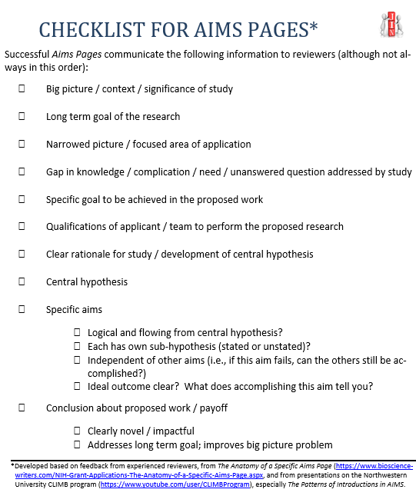
DE-INBRE Flight School: Specific Aims Page
Robert Akins, PhD
Considered the SINGLE MOST IMPORTANT PAGE OF THE GRANT PROPOSAL
Start early.
Work closely with your mentor.
Consider contacting Erin.Riegel@Nemours.org to set up a M/AC pre-submission review.

Slide 12
DE-INBRE Flight School: Research Plan Pages
Robert Akins, PhD
Six pages
Significance
Innovation
Approach

Slide 13
DE-INBRE Flight School: Resources and Environment
Robert Akins, PhD
AN ASSESSMENT OF RESOURCES AND ENVIRONMENT IS INCLUDED IN REVIEW
Facilities to be used - capacities, capabilities, proximity, availability, etc.
How the scientific environment will contribute to success (e.g., institutional support, physical resources, and intellectual rapport).
Institutional investment in the investigator (e.g., resources for classes, travel, training; collegial support such as career enrichment programs; assistance and guidance in the supervision of trainees; protected time, etc.).
Special facilities for biohazards or other potentially dangerous substances.

Slide 14
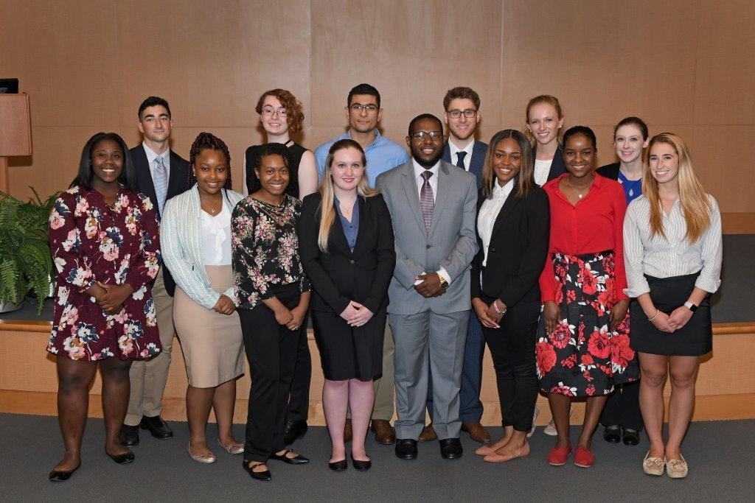
DE-INBRE Flight School: Undergraduate Inclusion Plan
Robert Akins, PhD
One page for Research Independence Awards.
Unlimited pages for Research Engagement Awards involving training of undergrads (e.g., targeting an R15).

Slide 15
DE-INBRE Flight School: Individual Development Plan
Robert Akins, PhD
Online form to be filled out with your mentor.
https://www.de-ctr.org/redcap/surveys/?s=X3MDE39WE4

Slide 16
DE-INBRE Flight School: Mentoring Plan and Letter from Mentor
Robert Akins, PhD
Online form completed by each mentor online. To complete the mentoring plan, the mentor should have available https://redcap.nemoursresearch.org/redcap/surveys/?s=8FTCPX4FPC
The Pilot Investigator’s name and proposal title.
Information on previous mentees/trainees.
The areas in which the investigator will develop research expertise.
The names and roles of any other mentors who will assist on the project.
A letter that expands on mentoring plan is also requested.

Slide 17
DE-INBRE Flight School: Letters of Support
Robert Akins, PhD
Department Head / Division Chief
Any Core Director(s)
Any Collaborating Investigator(s)

Slide 18
DE-INBRE Flight School: Plans for Human Subjects Research
Robert Akins, PhD
This is big.
Follow guidance at https://research.udel.edu/regulatory-affairs/human-subjects/.
If you plan to include human subjects in your study, contact us as soon as possible at info@de-inbre.org.

Slide 19
DE-INBRE Flight School: Plans for Use of Vertebrate Animals
Robert Akins, PhD
See https://olaw.nih.gov/guidance/vertebrate-animal-section.htm and https://public.csr.nih.gov/FAQs/ReviewersFAQs/VertebrateAnimals.
The vertebrate animal justification and protection section should cover:
Description of Procedures
Justifications
Minimization of Pain and Distress
Euthanasia (Note, that in standard NIH forms, the method of euthanasia is addressed in the Cover Page Supplement; however, DE-INBRE requests that it be provided in this section).

Slide 20
DE-INBRE Flight School: IRB and IACUC Approval Memoranda
Robert Akins, PhD
***THIS IS REQUIRED***
All JIT documents (including final IRB and IACUC approval memoranda), Assurance that all regulatory approvals are in place (IBC, Radiation Safety, etc.), and a signed investigator agreements must be provided to the INBRE Director of Research by July 16, 2021.
No Exceptions.

Slide 21
DE-INBRE Flight School: Prior Awards Statement
Robert Akins, PhD
For each previous project supported by CTR, DE-INBRE, any COBRE, or the DHSA should include a summary of that prior work (1 page maximum for each prior award) including summarizing successes toward acquiring independent external support and explaining why further support is necessary.

Slide 22
DE-INBRE Flight School: Questions
Robert Akins, PhD
info@de-inbre.org

